Slide 1


초등학교 5
10. Where Is the Library?
교과서 143쪽
Play Time 1
이심전심!
장소 찾기 놀이

Slide 2
Let’s Play!

Slide 3
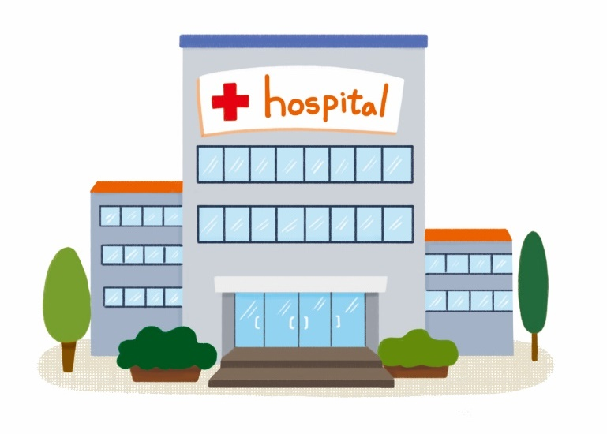
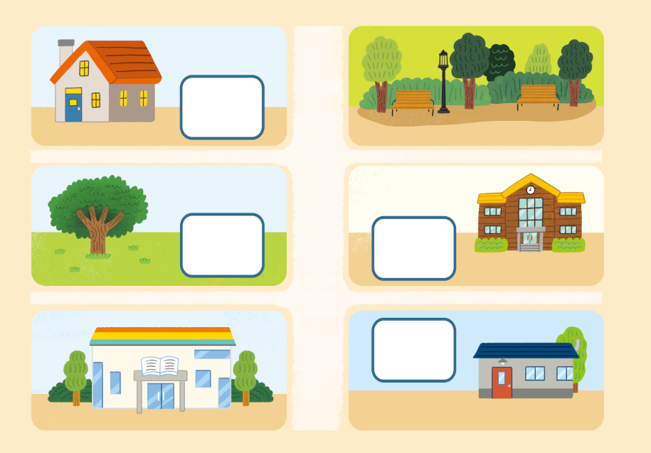
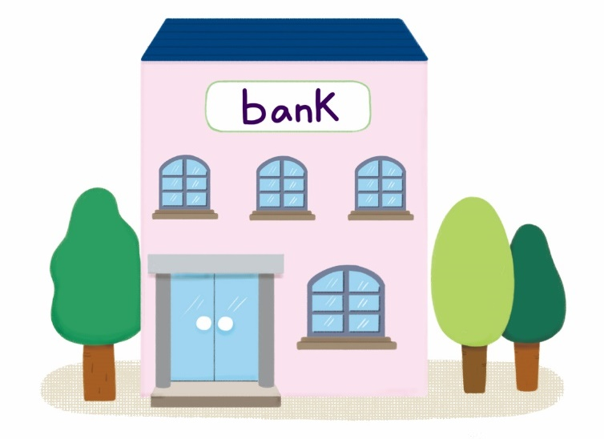

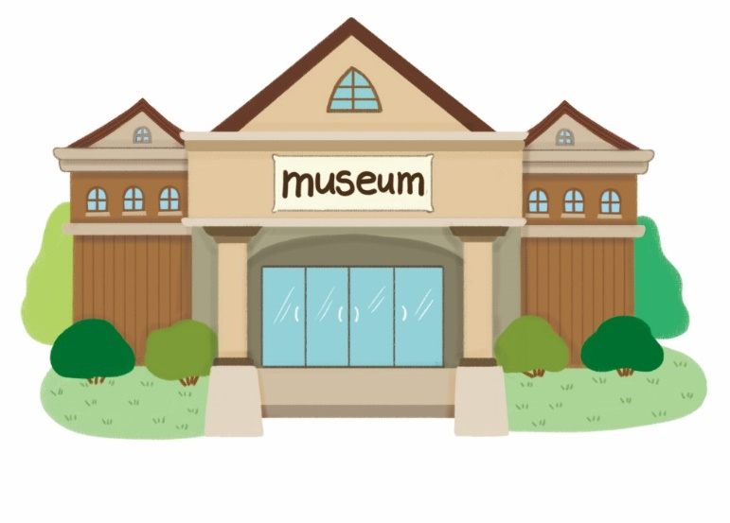
①
②
③
④

Slide 4
①

Slide 5
②

Slide 6
③

Slide 7
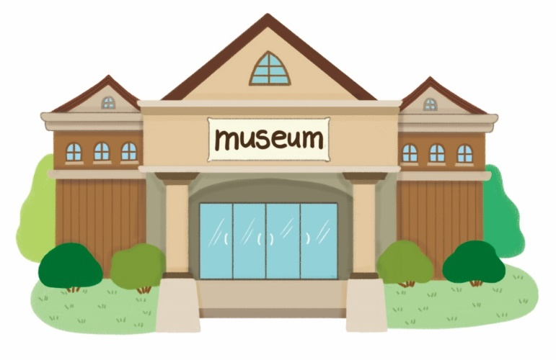
④

Slide 8
정답
①
④
③
②

Slide 9
Teachers’ Only

Slide 10



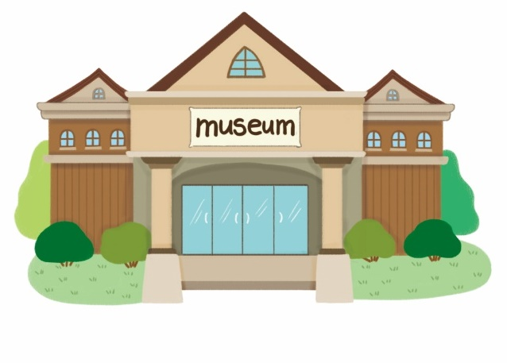
수업 중에 출력하여 사용하세요.
① | Go straight two blocks and turn left. It’s on your right.
② | Go straight one block and turn right. It’s on your right.
③ | Go straight one block and turn right. It’s on your left.
④ | Go straight one block and turn left. It’s on your right.

